Slide 1

Capture The Flag
NAME: TRI HO
Team Name: ELECTRONIC HOUND (Team 4)

Slide 2
Introduction
The CTF Problem: Log Analysis
Steps to Solve
The Solution
Workplace Relevance
Notes:
Tell your audience what you intend to cover in your project. This is the purpose of your communication.
In Section 1, provide some background of the category of your CTF challenge.
Introduce the audience to the problem and tell us how you plan to approach it and get the solution.
In Section 2, cover the steps you used to solve the problem. This may cover multiple solves.
In Section 3, talk about how you found the solution and discuss the pitfalls and recommendations when facing these types of problems.
In Section 4, talk about the relevance of Capture the Flag problems to the workplace and your job role.

Slide 3
CTF Category Description
Log files are a historical record of everything and anything that happens within a system, including transactions, errors, and intrusions. That data can be transmitted in structured, semi-structured, and unstructured ways. [1]
The basic anatomy of a log file includes timestamp, user information, and event information. [2]
The hacker can tamper with the log to erase their track and make the system appear normal. Therefore, Ethical Hackers need to understand the log mechanic and how to analyze them.
Lab 3
Notes:
Before presenting this problem, discuss the category of the CTF challenge and the relevant skills needed to solve this type of problem.
Answer the four questions below in your slide and make these questions your talking points.
Describe the category of question that you attempted.
What is the important background knowledge needed?
How does this relate to the Ethical Hacking course?
What lab in the course covered the topic from this CTF problem?

Slide 4
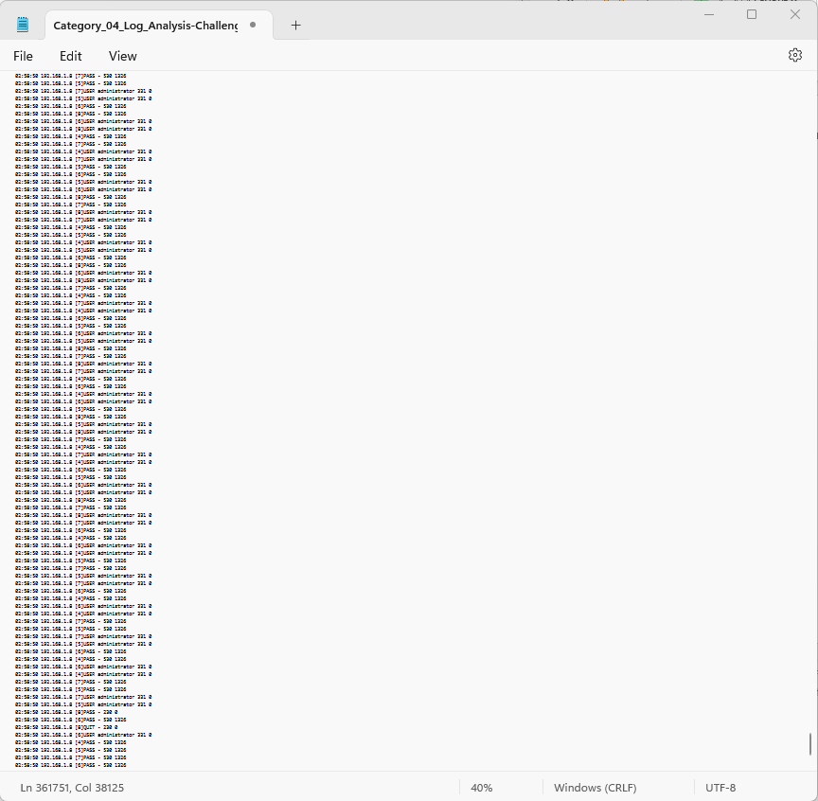
Introduction to the Problem
Present a large log file of a system with 361757 entries generates with time stamps.
Find how many log entries were generated at 02:56:34

Slide 5
Working toward a solution
Steps to Solve
Search for the required entry in the log
Take note of any repeating pattern of the entries
Since the entry term only appears once per row as a time indicator of when the log was first generated
Proceed to count the rows
<insert required narration>

Slide 6
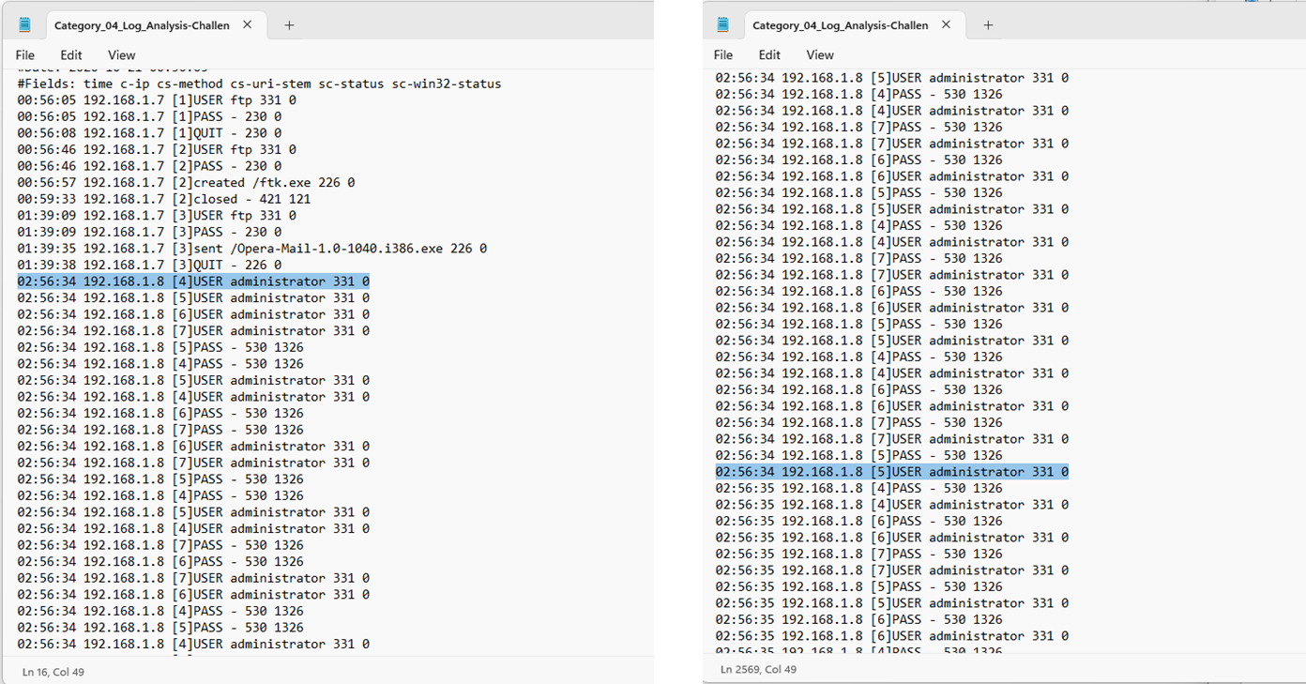
Working Toward a Solution
Notes:
Note that since 02:56:34 is a time stamp, therefore every line should only have “02:56:34” appears once
Find the first log entry with time stamp 02:56:34, then take note of the Line number.
Repeat this step for the last entry with this time stamp, and take note of the Line number.

Slide 7
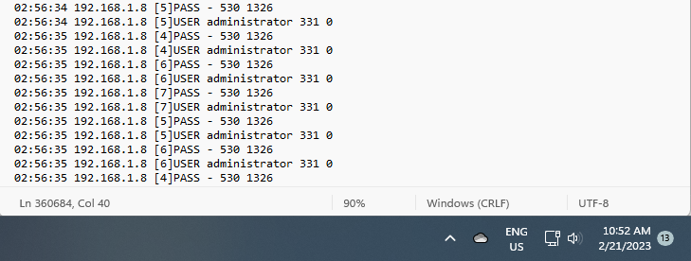
Arriving at the Solution
Once we locate the last entry with 02:56:34, we can count the total number of lines that have this timestamp
Subtract the last line number with the first line number where the entry start, and plus 1 will get us the total line of 2554
The screenshot below includes the date/time from the host system.

Slide 8
Strategies, Pitfalls, Lessons Learned
This strategy can be applied to look for a specific term in a large data set. Since every log starts with a time stamp, counting the line can achieve the intended result.
For this strategy to work, the search term has to appear exactly once per line, line# = word count
If we only have a search parameter but not a specific string, it will make the counting more complex and require a specialized tool. For instance, if we need to know how many entries have “pa*” in them.
When all available tools are exhausted and no solution is found, the log analyst must write up a Python count program. [3]
Notes:
In this section, discuss some of the strategies you used to solve your CTF problem, as well as some of the pitfalls that can lead to the wrong path. This will all be part of the lessons learned section that will help you know how to approach this kind of problem.

Slide 9
The Relationship to the Workplace
Analyzing logs is one of the tasks that cyber defense use to monitor the network/system. Log tampering can be revealed by log analysis
Log reading is not as graphically appealing as network traffic monitoring; however, it reveals solid early indicators and evidence of a compromised system.
Capture the Flag (CTF) challenges require critical thinking to solve. When the first and sometimes even the second methods don’t provide the solution, CTF motivates me to think outside the box and find other methods to show the problem.
CTF provides a single-point target and encourages me to practice the essential skills to be a good Pen Tester, such as analyzing malware, checking logs, reading registry files, and capturing network packets. It is easier to practice these skills when I know what I want. In a real network or a system, I would not know what I am looking for but do a blind check for anything that appears out of the ordinary, which can be very arbitrage.
Teamwork! Maximizing the team’s strength is one of the most important skills. Since we have different experiences and levels of expertise, which resemble a real Pen Test team from junior staff to senior staff and team leaders.
Notes:
In this section, discuss Capture the Flag competitions can benefit you in the workplace.

Slide 10
Summary
It is up to the attacker to find a way to solve these problems in real time, and the better and faster they get to the solution, the higher their success rate will be.
Ethical Hackers being creative and providing batches/fixes before the attacker can exploit these vulnerabilities.
As we continue improving the system’s security, the attacker put in just about the same effort to crack it. It is a non-stop endeavor and will get increasingly more advanced when newer technologies roll out.
CTF challenges provide problems that require the student to be creative in finding the resolution. This is an excellent exposure since we scan a system or network in real life for possible vulnerability and exploitation.
Notes:
This is your summary and your last opportunity to connect with your audience.
Do not merely repeat your agenda topics. Add one to two important details about each main point to review for your audience.
What is/are the main takeaway(s)?

Slide 11
References
[1, 2]“Log Files: Definition, Types, and Importance | CrowdStrike,” crowdstrike.com. https://www.crowdstrike.com/cybersecurity-101/observability/log-file/
[3]‌“Python - How Do I Count the Number of Characters in a Code Using Accumulation Pattern without Using Len()?” Stack Overflow, https://stackoverflow.com/questions/54507982/how-do-i-count-the-number-of-characters-in-a-code-using-accumulation-pattern-wit Accessed 26 Feb. 2023.
<insert narration>

